Slide 1
Solar Cell Characterization
By Adeline Antolis and Malith Rajapakse 23rd May 2018
Notes:
Add in dates. Keep clean and neat.

Slide 2
What is a solar cell?

Slide 3
What is solar cell characterization?
Quantitave tool to measure the performance of a solar cell
Provides vital information on different factors affecting the performance
Used to compare different solar cells
Gives researchers ideas on how to improve a solar cell
Notes:
Motivation for the research. We have 40 research doing research for solar cell research and printable. 100 solar cells in 1 hr.

Slide 4
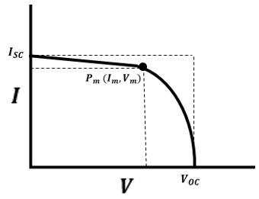

How are solar cells characterized?
Modelling I-V curve (current-voltage) and extracting parameters in the mathematical model
Important points:
Short circuit current $I_{SC}$
Open circuit voltage $V_{OC}$
Maximum power point $P_{M}$
Notes:
Introduce a solar cell. (30 seconds). You apply voltage across not against and you step the voltage and measure the current at each point.

Slide 5
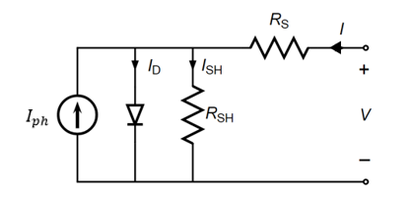
Existing Models
Models of equivalent electrical circuit -Single diode
Notes:
Circle and explain. Take about recombination. High the voltage the more charge is recombined.
100 solar cells in one hour.

Slide 6

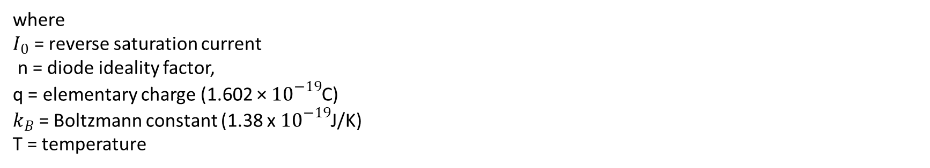
How is the mathematical model obtained?
Single Diode Model
Shockley Diode equation:
$${ I}_{D}= I_{0}\left(e^{\frac{q\left(V−R_{s}I\right)}{nk_{B}T}}−1\right)$$
where $I_{0}$ = reverse saturation current n = diode ideality factor, q = elementary charge (1.602 × ${10}^{−19}$C) $k_{B}$ = Boltzmann constant (1.38 x $10^{−19}$J/K) T = temperature

Slide 7

Application of Ohm’s Law (V=IR) to obtain $I_{sh}$:
$V_{sh}=V−R_{s}I$
$I_{sh}=\frac{V_{sh}}{R_{sh}}$ = $\frac{V−R_{s}I}{R_{sh}}$
Application of Kirchhoff's junction rule to obtain $I$: $I=I_{D}+I_{sh}−I_{ph}$
$I=I_{0}\left(e^{\frac{q\left(V−R_{s}I\right)}{nk_{B}T}}−1\right)+\frac{V−R_{s}I}{R_{sh}}−I_{ph}$ → Characteristic equation
Notes:
Make font size larger

Slide 8
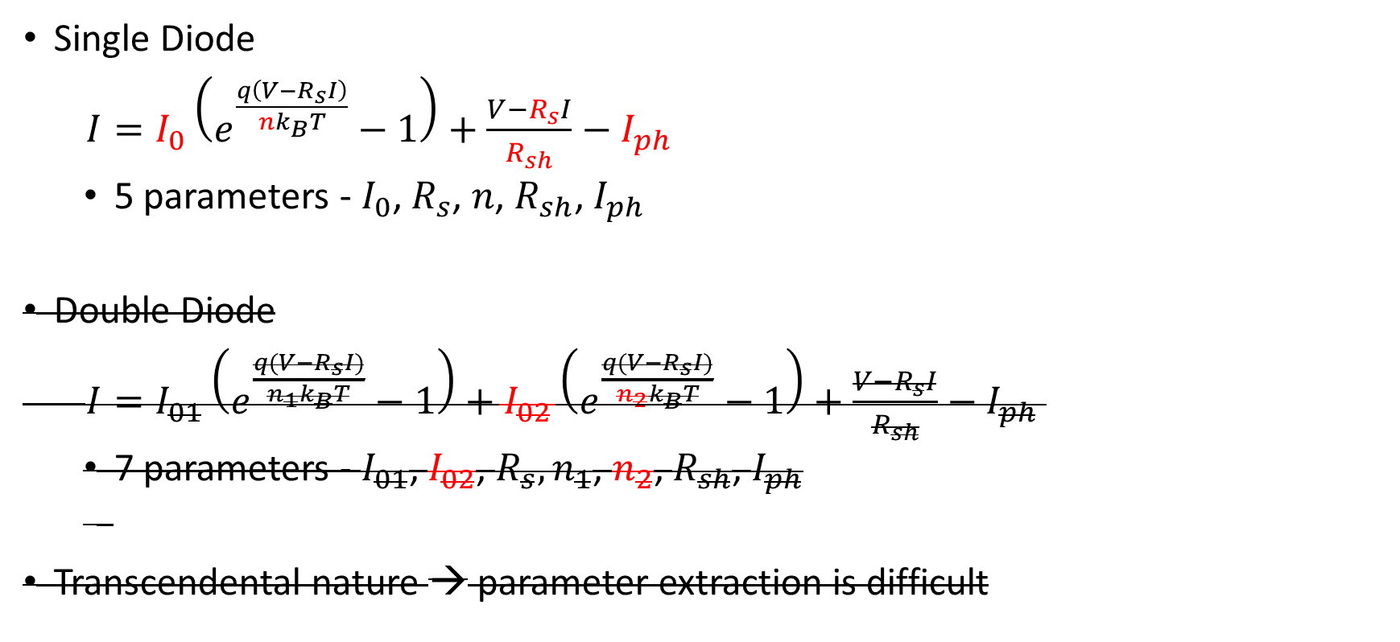
Characteristic equations
Single Diode
$I=I_{0}\left(e^{\frac{q\left(V−R_{s}I\right)}{nk_{B}T}}−1\right)+\frac{V−R_{s}I}{R_{sh}}−I_{ph}$
5 parameters - $I_{0}$, $R_{s}$, ${n\text{, }R_{sh}\text{,} I}_{ph}$
Double Diode
$I=I_{01}\left(e^{\frac{q(V−R_{s}I)}{n_{1}k_{B}T}}−1\right)+I_{02}\left(e^{\frac{q(V−R_{s}I)}{n_{2}k_{B}T}}−1\right)+\frac{V−R_{s}I}{R_{sh}}−I_{ph}$
7 parameters - $I_{01}$, $I_{02}$, $R_{s}, n_{1}$, $n_{2}$, $R_{sh}$, $I_{ph}$
Transcendental nature → parameter extraction is difficult
Notes:
Just say that it in general terms.
Highlight the current in a different color like blue.

Slide 9
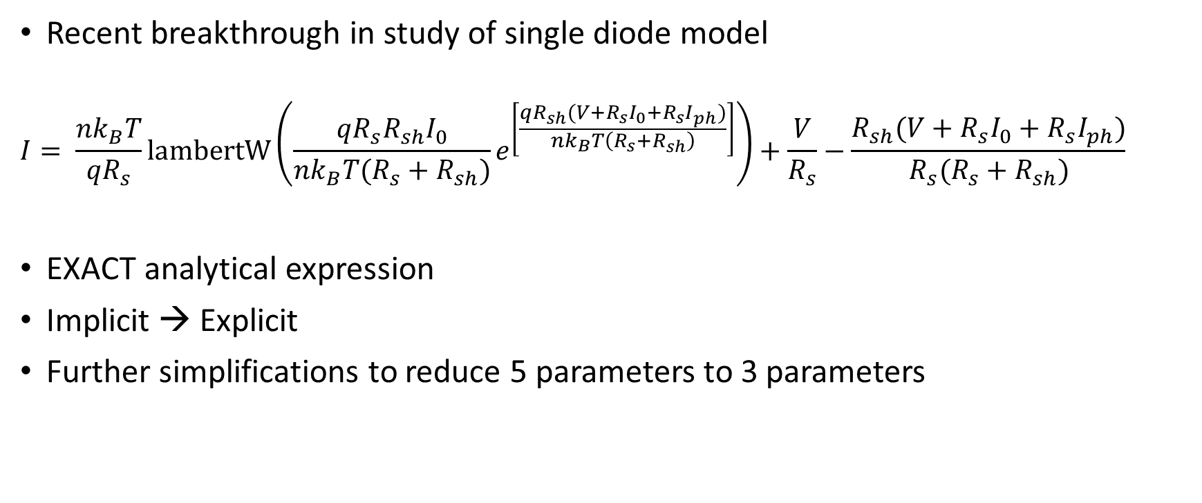
Lambert W Function
Recent breakthrough in study of single diode model
$$I= \frac{nk_{B}T}{{qR}_{s}}lambertW\left(\frac{qR_{s}R_{sh}I_{0}}{nk_{B}T(R_{s}+R_{sh})}e^{\left[\frac{qR_{sh}(V+R_{s}I_{0}+R_{s}I_{ph})}{nk_{B}T\left(R_{s}+R_{sh}\right)}\right]}\right)+\frac{V}{R_{s}}−\frac{R_{sh}(V+R_{s}I_{0}+R_{s}I_{ph})}{R_{s}(R_{s}+R_{sh})}$$
EXACT analytical expression
Implicit → Explicit
Further simplifications to reduce 5 parameters to 3 parameters
Notes:
No Italics of lambert W

Slide 10
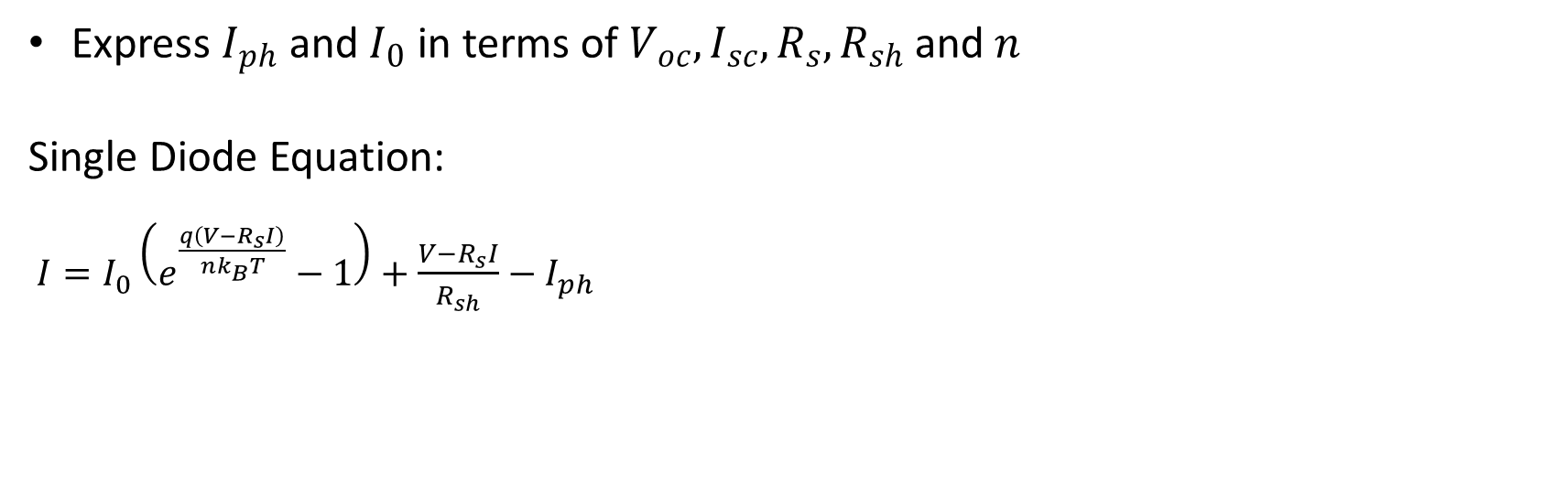

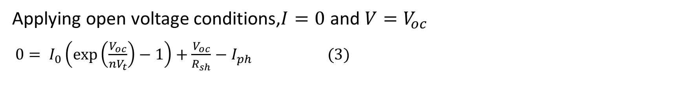
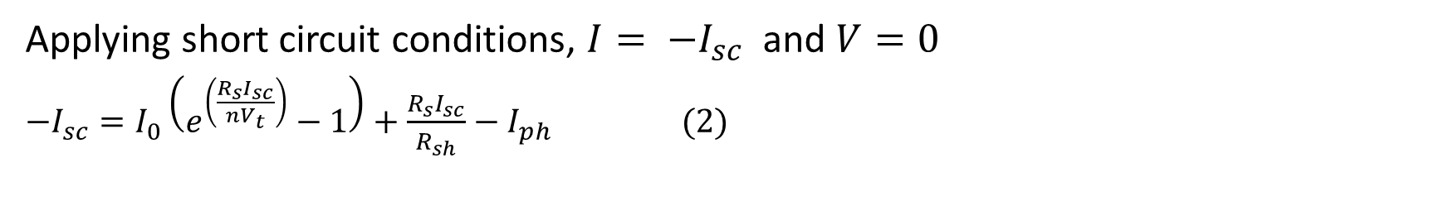
Simplifications
Express $I_{ph}$ and $I_{0}$ in terms of $V_{oc}, I_{sc}, R_{s},R_{sh}$and $n$
Single Diode Equation:
$I=I_{0}\left(e^{\frac{q\left(V−R_{s}I\right)}{nk_{B}T}}−1\right)+\frac{V−R_{s}I}{R_{sh}}−I_{ph}$
Applying short circuit conditions, $I= −I_{sc}$ and $V=0$ $\begin{aligned}−I_{sc}=I_{0}\left(e^{\left(\frac{R_{s}I_{sc}}{nV_{t}}\right)}−1\right)+\frac{R_{s}I_{sc}}{R_{sh}}−I_{ph} (2) \#\end{aligned}$
where $V_{T}=\frac{q}{k_{B}T}$
Applying open voltage conditions,$I=0$ and $V=V_{oc}$
$\begin{aligned}0= I_{0}\left(\exp\left(\frac{V_{oc}}{nV_{t}}\right)−1\right)+\frac{V_{oc}}{R_{sh}}−I_{ph} (3) \#\#\end{aligned}$
Notes:
Remove as much of the maths. Copy these slides to the end

Slide 11
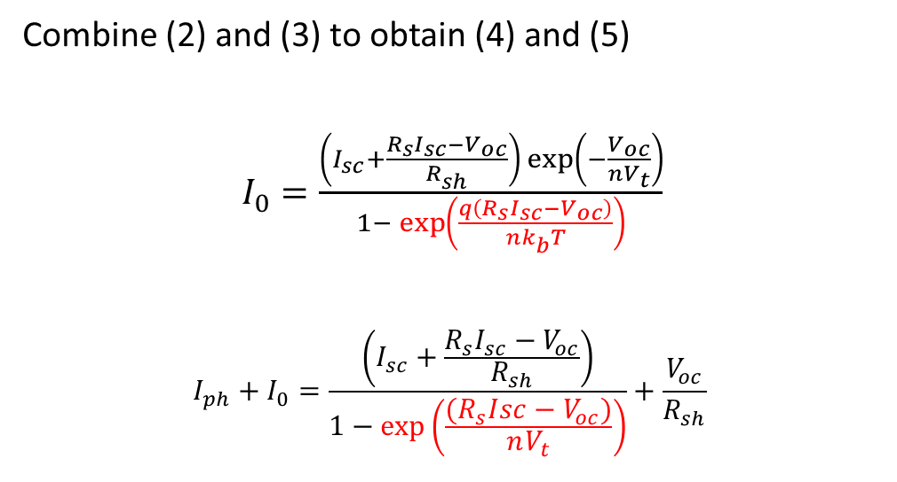

Combine (2) and (3) to obtain (4) and (5)
$\begin{aligned}I_{0}=\frac{\left(I_{sc}+\frac{R_{s}I_{sc}−V_{oc}}{R_{sh}}\right)\exp\left(−\frac{V_{oc}}{nV_{t}}\right)}{1− \exp\left(\frac{q\left(R_{s}I_{sc}−V_{oc}\right)}{nk_{b}T}\right)}\#\end{aligned}$
$$\begin{aligned}I_{ph}+I_{0}=\frac{\left(I_{sc}+\frac{R_{s}I_{sc}−V_{oc}}{R_{sh}}\right)}{1−\exp\left(\frac{{(R}_{s}Isc−V_{oc})}{nV_{t}}\right)}+\frac{V_{oc}}{R_{sh}} \#\end{aligned}$$
(4)
(5)
If the term $$\begin{aligned}\exp\left(\frac{q\left(R_{s}I_{sc}−V_{oc}\right)}{nk_{b}T}\right)≪1 \end{aligned}$$
(5) can be reduced to
$$\begin{aligned}I_{ph}+I_{0}=I_{sc}+\frac{R_{s}I_{sc}}{R_{sh}} \#\end{aligned}$$
(6)
Notes:
Simplier , straightfoward

Slide 12

Combining (6) with exact analytical expression for lambert w function
$$I = \frac{nk_{B}T}{{qR}_{s}}W\left(\frac{qR_{s}}{nk_{B}T}\left({I_{sc}−\frac{V_{OC}}{R_{s}+R_{sh}}e}^{\left[\frac{−qV_{OC}}{nk_{B}T}\right]}e^{\left[\frac{q}{nk_{B}T}\left(R_{s}I_{sc}+\frac{R_{sh}V}{R_{s}+R_{sh}}\right)\right]}\right)\right)+ \frac{V}{R_{s}}−I_{sc}−\frac{R_{sh}V}{R_{s}(R_{s}+R_{sh})}$$
Only 3 parameters – $R_{s}$, $n$, $R_{sh}$
Parameter extraction is significantly simpler
Notes:
Say that we are understand that it is not for reading right now

Slide 13

Initial Values
Specify initials value for $R_{s}$, $n \text{and} R_{sh}$ to initiate calculation of parameters
One method by Zhang et al. substitutes $I_{sc}$ and $V_{oc}$ conditions into $\frac{dV}{dI}$
At $I_{sc} conditions:$
$\frac{dV}{dI}=$ $R_{sh}$ $+ R_{s} \text{≈} R_{sh}$
(7)
Notes:
Reference. Add a footnote. It should contain just the author, jornal,year,volume,year DELETE

Slide 14
Problem Statement
Accuracy of parameter extraction depends on initial guesses
Bad initial guesses → unrealistic parameters
Notes:
Put the problem statement as early as possible. Have a aim slide, what is the aim and keep the

Slide 15
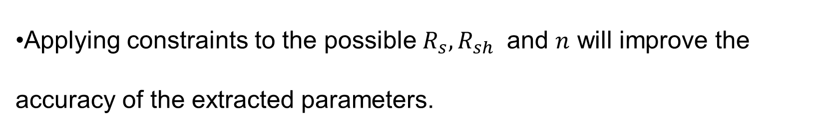
Hypothesis
Applying constraints to the possible $R_{s},R_{sh}$ and $n$ will improve the accuracy of the extracted parameters.
Objectives
Apply constraints to the parameters to improve accuracy of parameter extraction
Investigate for wide range of solar cells
Notes:
The future work cannot be the same as hypothesis.

Slide 16
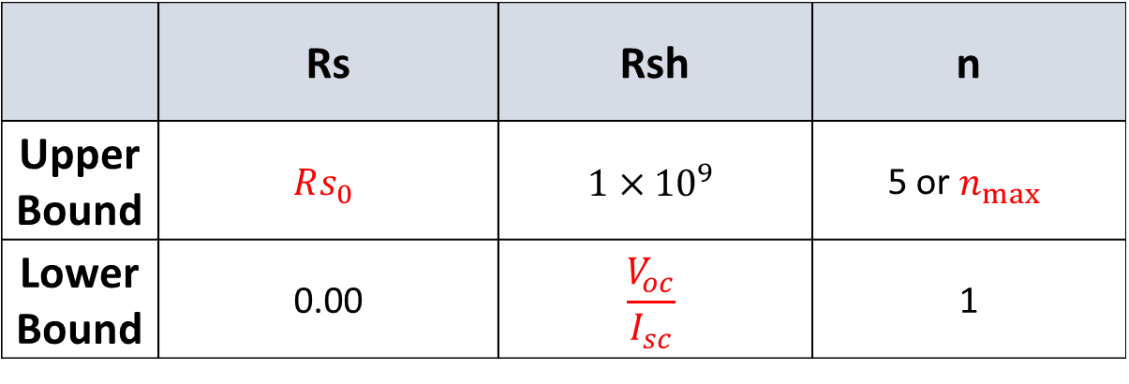
Parameter Constraints
 | Rs | Rsh | n
Upper Bound | $$Rs_{0}$$ | $$1×{10}^{9}$$ | 5 or $n_{max}⁡$
Lower Bound | 0.00 | $$\frac{V_{oc}}{I_{sc}}$$ | 1
Reduce the residual error between the experimental data and model

Slide 17
Methodology
Compare %error of extracted parameter from simulated parameters.
Compare root mean squares error (RMSE) for a literature solar cell IV curve.
Compare RMSE for a perovskite solar cell IV curve.

Slide 18
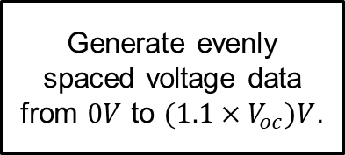
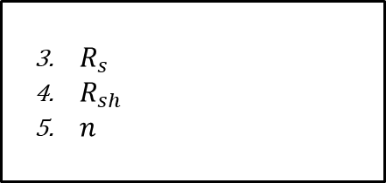
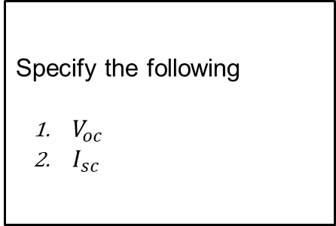
Simulate IV data
Specify the following
$V_{oc}$
$I_{sc}$
Introduce noise with signal to noise ratio (SR) of 45
Generate evenly spaced voltage data from $0V$ to $(1.1×V_{oc})V$.
Generate current with explicit single diode equation.
$R_{s}$
$R_{sh}$
$n$
Notes:
Remove the asterisk and put in multiplication symbol.
You need to explain why you are simulating data

Slide 19
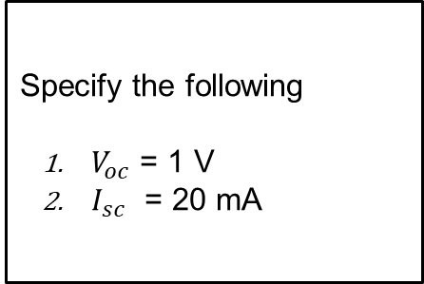
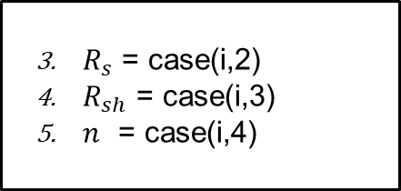
Simulated cases
Case | Rs (Ω) | Rsh (kΩ) | n
1 | 0.10 | 1.00E+03 | 1.00
2 | 25.00 | 1.00E+03 | 1.00
3 | 0.10 | 0.20 | 1.00
4 | 0.10 | 1.00E+03 | 2.50
5 | 25.00 | 1.00E+03 | 2.50
6 | 0.10 | 0.20 | 2.50
7 | 0.10 | 1.00E+03 | 5.00
8 | 25.00 | 0.20 | 5.00
Specify the following
$V_{oc}$ = 1 V
$I_{sc}$ = 20 mA
$R_{s}$ = case(i,2)
$R_{sh}$ = case(i,3)
$n$ = case(i,4)
Notes:
No need to explain.
Put in 1000’s instead of E
Reduce the number of cases.
Put ohms all the time

Slide 20
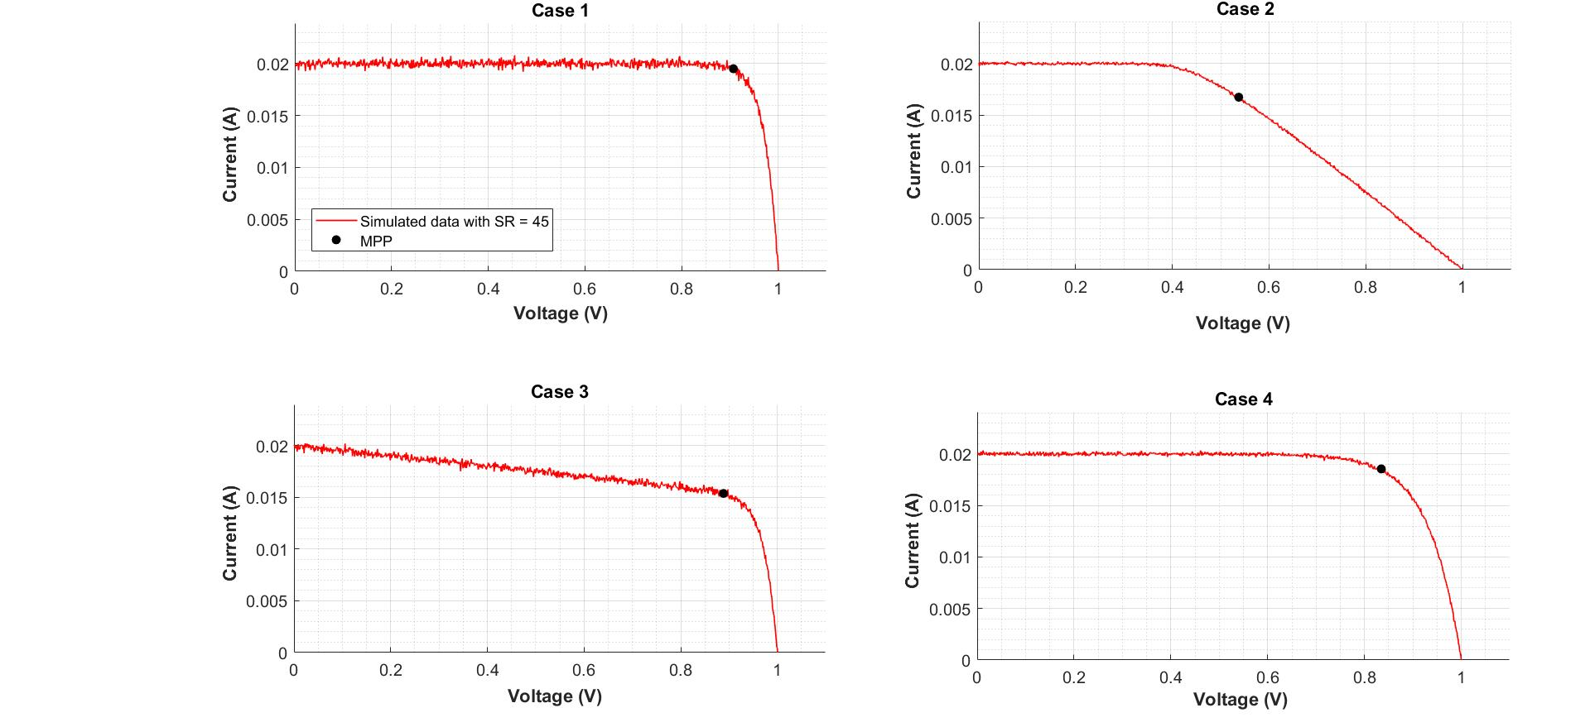
Simulated cases 1 - 4
Case | Rs (Ω) | Rsh (kΩ) | n
1 | 0.10 | 1.00E+03 | 1.00
2 | 25.00 | 1.00E+03 | 1.00
3 | 0.10 | 0.20 | 1.00
4 | 0.10 | 1.00E+03 | 2.50
Notes:
Case 1
Case 2
Case 3
Case 8

Slide 21
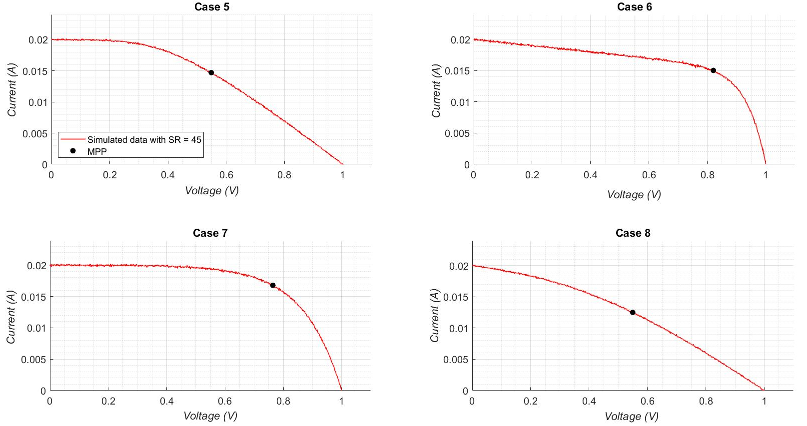
Simulated cases 5 - 8
Case | Rs (Ω) | Rsh (kΩ) | n
5 | 25.00 | 1.00E+03 | 2.50
6 | 0.10 | 0.20 | 2.50
7 | 0.10 | 1.00E+03 | 5.00
8 | 25.00 | 0.20 | 5.00

Slide 22
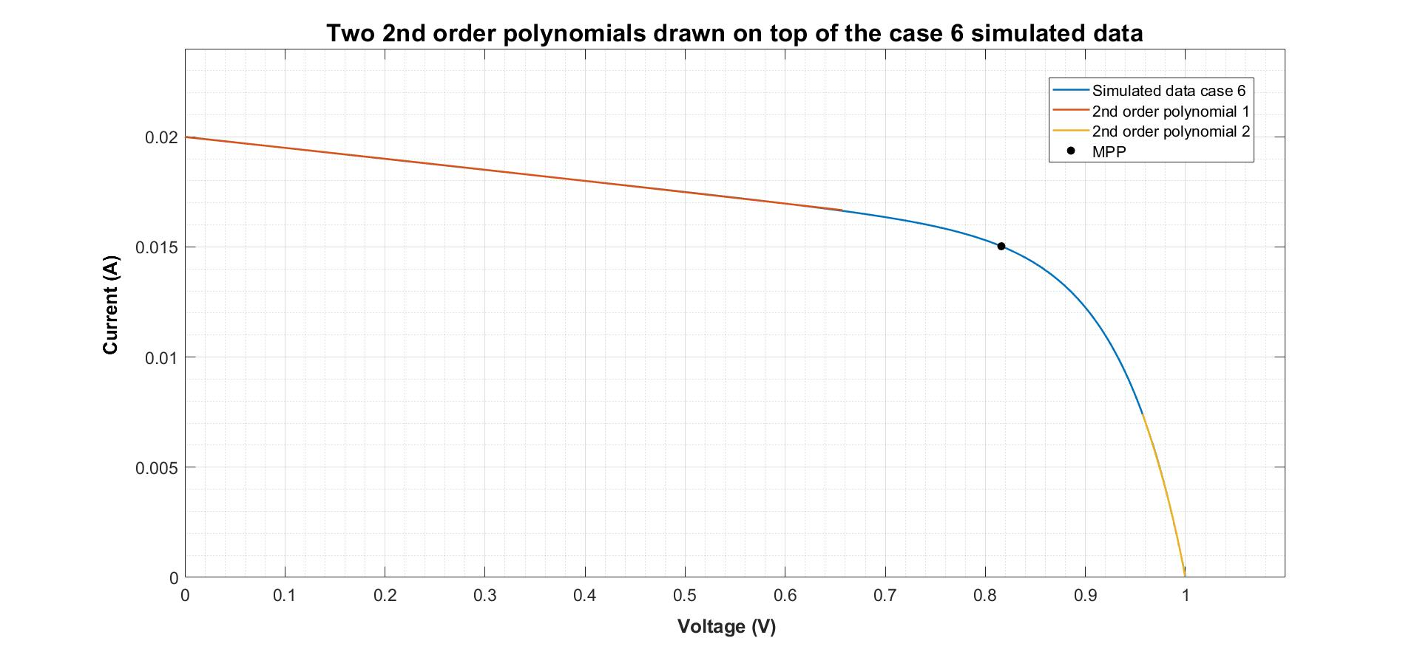


Parameter extraction: Gradients at $V = 0$and $V = V_{oc}$
Notes:
Remove everything on the slide.
To get the initial guess we need to get the gradients.
Colour code the gradients.

Slide 23
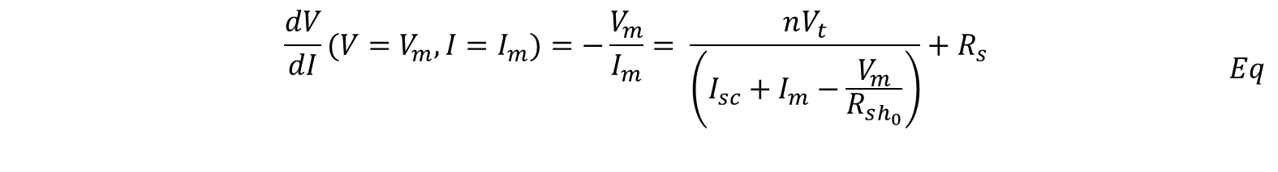
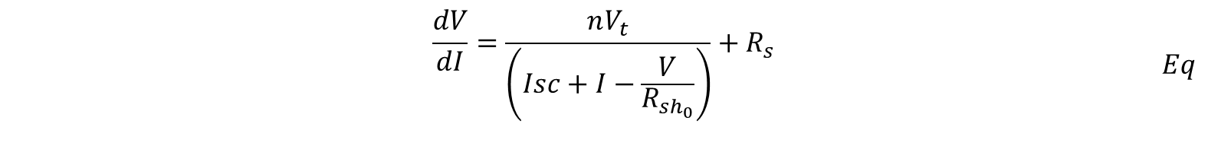
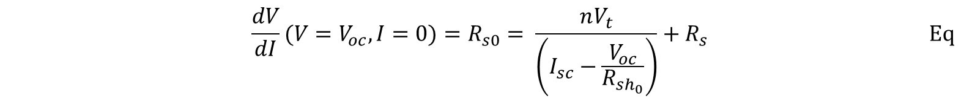
Parameter extraction (2) : Initial guesses
$$\begin{aligned}\begin{aligned}&\frac{dV}{dI}=\frac{nV_{t}}{\left(Isc+I−\frac{V}{R_{sh_{0}}}\right)}+R_{s}\#\#\end{aligned}\#Eq\end{aligned}$$
$$\begin{aligned}\begin{aligned}&\frac{dV}{dI}(V=V_{m}, I=I_{m})=−\frac{V_{m}}{I_{m}}= \frac{nV_{t}}{\left(I_{sc}+I_{m}−\frac{V_{m}}{R_{sh_{0}}}\right)}+R_{s }\#\end{aligned}\#Eq\end{aligned}$$
$$\begin{aligned}&\frac{dV}{dI}(V=V_{oc}, I=0)=R_{s0}= \frac{nV_{t}}{\left(I_{sc}−\frac{V_{oc}}{R_{sh_{0}}}\right)}+R_{s }\#\#Eq\end{aligned}$$

Slide 24
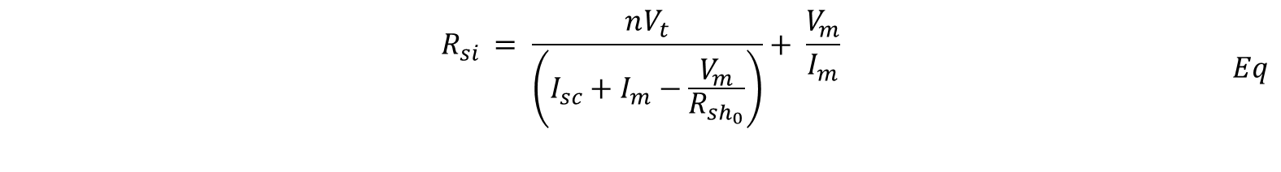
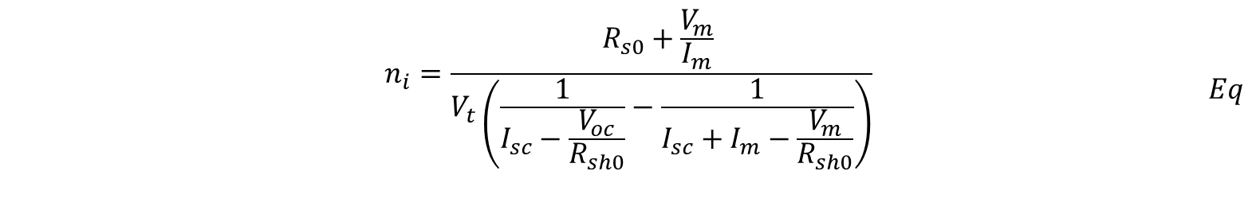
Equation 6 and 5 can be subtracted to obtain $n$ to as function of known parameters.
$$\begin{aligned}\begin{aligned}&n_{i}=\frac{R_{s0}+\frac{V_{m}}{I_{m}} }{V_{t}\left(\frac{1}{I_{sc}−\frac{V_{oc}}{R_{sh0}}}−\frac{1}{I_{sc}+I_{m}−\frac{V_{m}}{R_{sh0}}}\right)}\#\end{aligned}\#Eq\end{aligned}$$
$Rs$ can be retrieved by substituting the calculated in $n$ into equation (5). Equation (5) has been rearranged below to make $Rs$ as the subject of the formula.
$$\begin{aligned}\begin{aligned}&R_{si }= \frac{nV_{t}}{\left(I_{sc}+I_{m}−\frac{V_{m}}{R_{sh_{0}}}\right)}+ \frac{V_{m}}{I_{m}}\#\#\end{aligned}\#Eq\end{aligned}$$
$$\begin{aligned}&R_{shi }=R_{sh0}\#Eq\end{aligned}$$

Slide 25

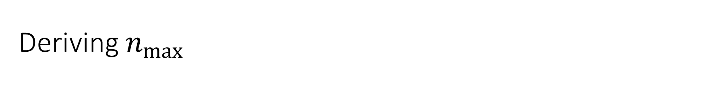

Deriving $n_{max}$
Recall
$$\begin{aligned}&R_{s0}= \frac{nV_{t}}{\left(I_{sc}−\frac{V_{oc}}{R_{sh_{0}}}\right)}+R_{s }\#\end{aligned}$$
Assume $Rs→ 0$and $Rsh→∞$
Is reduced to
$$n_{max}=\frac{R_{s0}I_{sc}}{V_{t}}$$

Slide 26
Results
Simulated IV characterization
Literature IV characterization
Perovskite sandwitch solar cells characterization

Slide 27
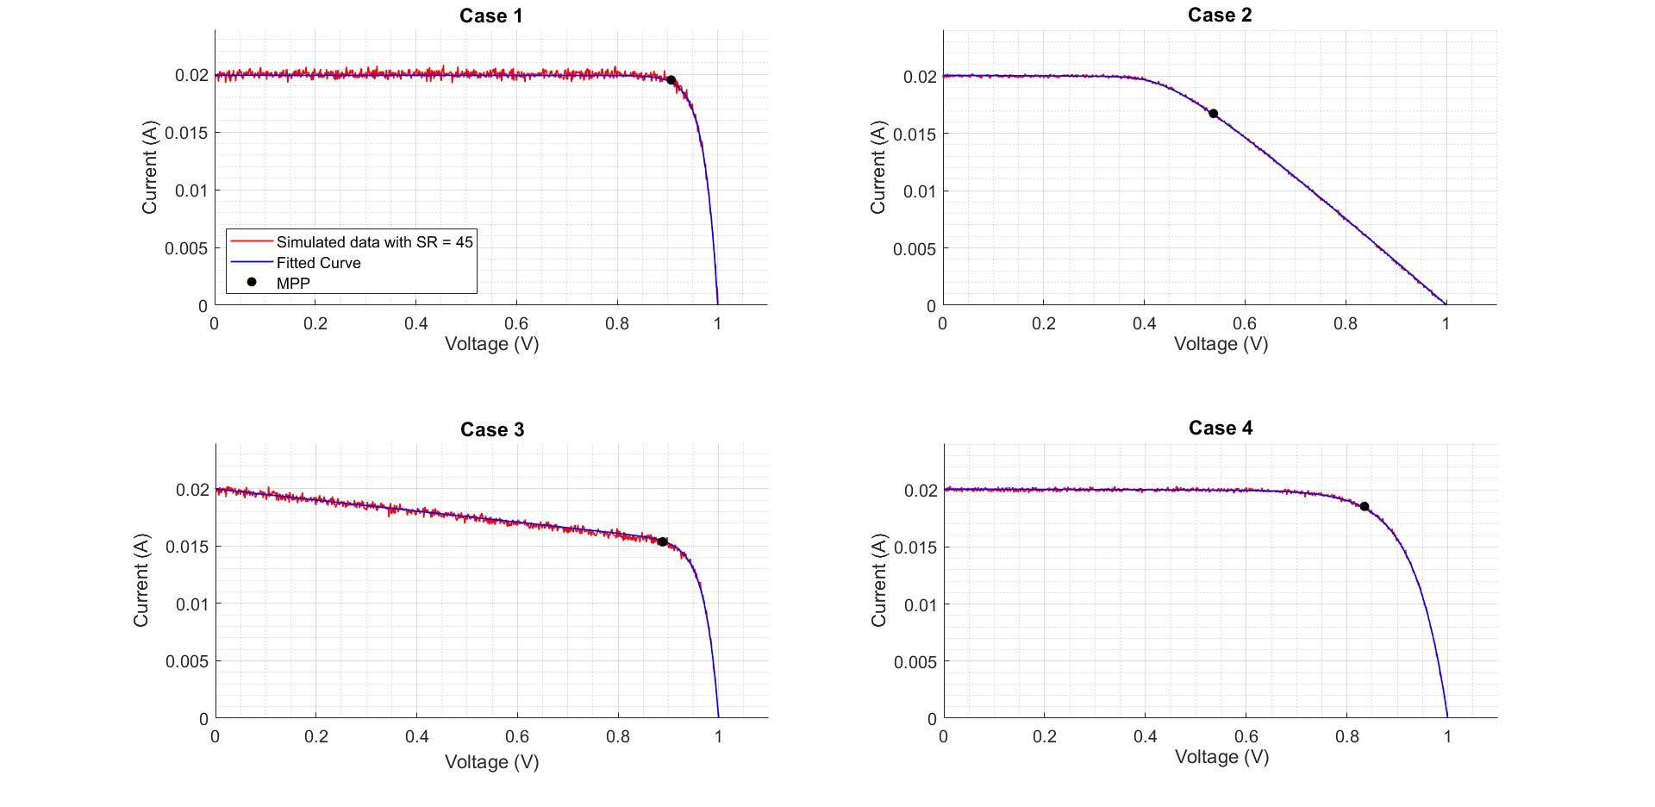
Simulated case 1 - 4

Slide 28
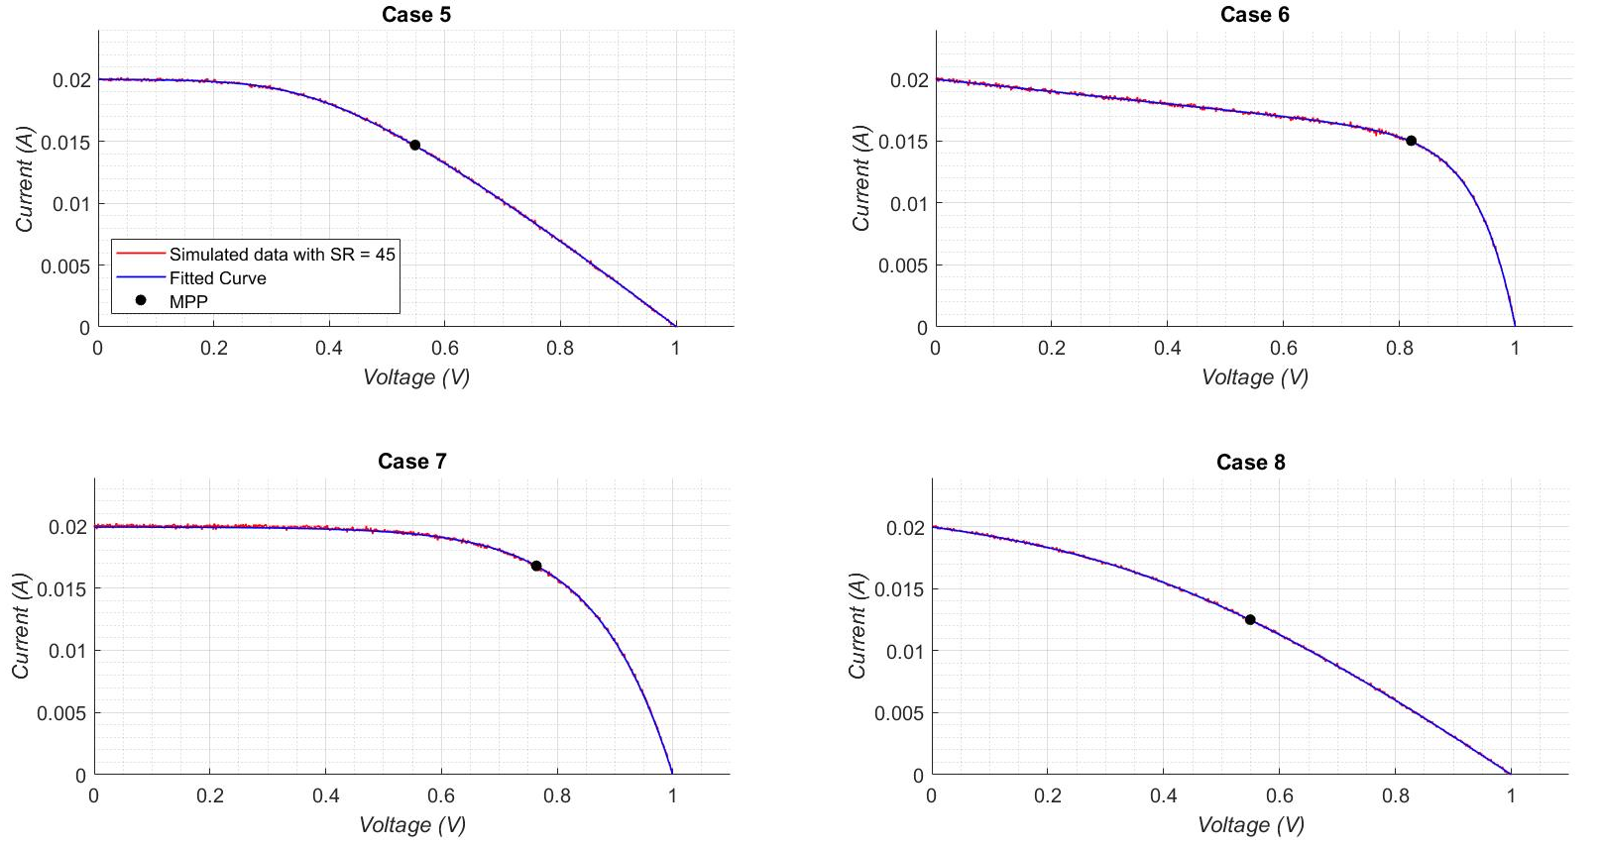
Simulated case 5 - 8

Slide 29
Simulated results
Case | Rs |  |  | Rsh |  |  | n |  |  | RMSE
 | Actual | Extract | %Error | Actual | Extract | %Error | Actual | Extract | %Error
1 | 0.10 | 0.07 | 33.08 | 1.00E+06 | 4.18E+04 | 95.82 | 1.00 | 1.00 | 0.00 | 1.32E-04
2 | 25.00 | 25.05 | 0.21 | 1.00E+06 | 4.22E+03 | 99.58 | 1.00 | 1.00 | 0.00 | 4.41E-05
3 | 0.10 | 0.00 | 99.90 | 2.00E+02 | 2.08E+02 | 3.85 | 1.00 | 1.06 | 5.53 | 1.12E-04
4 | 0.10 | 0.14 | 40.15 | 1.00E+06 | 6.63E+03 | 99.34 | 2.50 | 2.45 | 1.80 | 5.23E-05
5 | 25.00 | 25.22 | 0.86 | 1.00E+06 | 4.58E+03 | 99.54 | 2.50 | 2.42 | 3.09 | 3.20E-05
6 | 0.10 | 0.02 | 79.86 | 2.00E+02 | 2.02E+02 | 0.78 | 2.50 | 2.53 | 1.24 | 4.11E-05
7 | 0.10 | 0.53 | 426.42 | 1.00E+06 | 3.11E+04 | 96.89 | 5.00 | 4.72 | 5.55 | 7.62E-05
8 | 25.00 | 25.02 | 0.06 | 2.00E+02 | 2.09E+02 | 4.70 | 5.00 | 5.00 | 0.01 | 2.79E-05
Case 1 has highest RMSE in all cases
More noisy data
Large %error for high Rsh and low Rs
Low %error for n
RMSE is not ultimate indicator of accuracy
Observe case 3 and 1

Slide 30
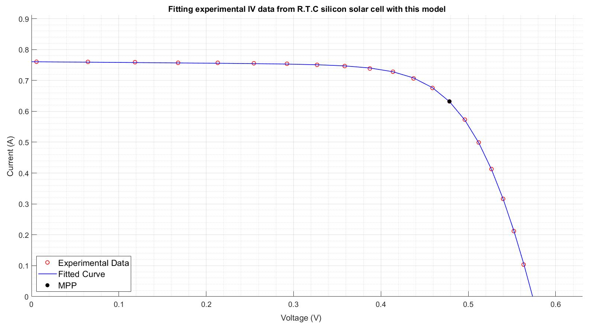
Fitting silicon solar cell IV data
Experimental data from a 57 mm diameter commercial (R.T.C France) silicon solar cell at 33 C.
Notes:
Explain the machine learning. Is sensitive and it doesn’t have physical meaning and based on

Slide 31
Comparing Bee Swarm Method with this model
Rs |  |  | Rsh |  |  | n |  |  | RMSE = ……
This method | Modified bee swarm | %Error | This method | Modified bee swarm | %Error | This method | Modified bee swarm | %Error | This method | Modified bee swarm | %difference
0.043 | 0.036 | 17.34 | 43.71 | 53.40 | 18.15 | 1.43 | 1.48 | 3.48 | 2.50E-03 | 9.86E-04 | 86.85
Notes:
Define RSME

Slide 32
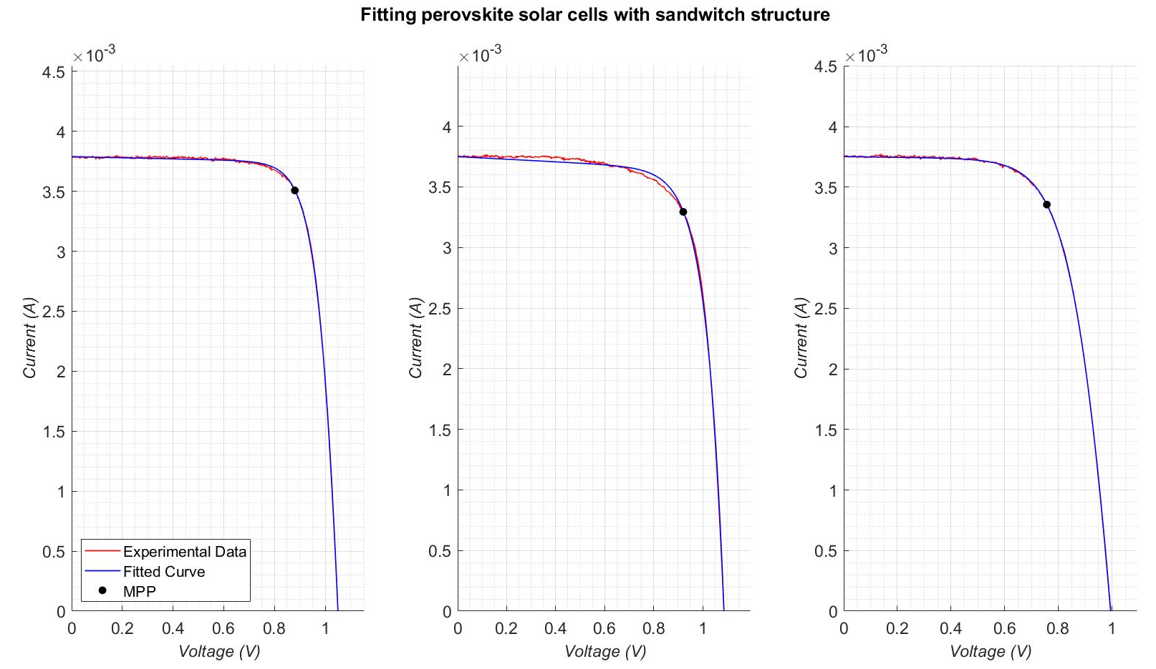
Fitting perovskite solar cells
Notes:
Make it clear that it is real data. The middle one doesn’t fit well due to abnomaility in the solar cells. Could be hysteresis.

Slide 33
Data | Rs | Rsh | n | RMSE
1 | 5.73 | 2.13E+04 | 2.10 | 1.07E-05
2 | 0.00 | 9.40E+03 | 2.76 | 2.88E-05
3 | 15.89 | 3.66E+04 | 3.11 | 6.50E-06
Notes:
Keep the scale the same. Don’t keep it as zero.

Slide 34
Conclusion

Slide 35
Limitations and future work
Cells with extremely large Rsh or low Rs cannot be extracted accurately
In some cases the single diode may not be an accurate representation of the IV data.
Notes:
Conclusion. Highlight what we achived. And we need do say everything we did. Just make it understand we.

Slide 36
Acknowledgments
Professor Udo Bach
Dr Kevin Reitwky
Dr Sonia

